Slide 1
Your Value Proposition, Resume, and Cover Letter
Your Questions
Cover Letter
Value Proposition
Career Management Overview
Resume

Slide 2
What questions do you have about career management?
Go to slido.com and enter #1723057

Slide 3
Parker Career Series Course Overview
Decision-Making | Branding | Networking | The Market | Interviewing
Product Market Fit Visioning Big 5 and Priorities Purpose 5-Years Negotiations Long-Term Career Paths | Your Brand Value Prop LinkedIn Resume Cover Letters 30 Second Pitch TMAY | Outreach Emotional Connections Relationship-Building Beyond Campus Recruiting Follow-Up | Definition Research Size and Growth Trends and Change Macro Changes | Why Role? Behaviorals STAR Strengths & Weaknesses Your Questions

Slide 4
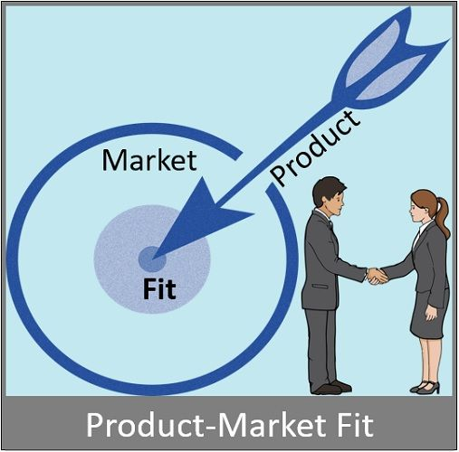

Slide 5
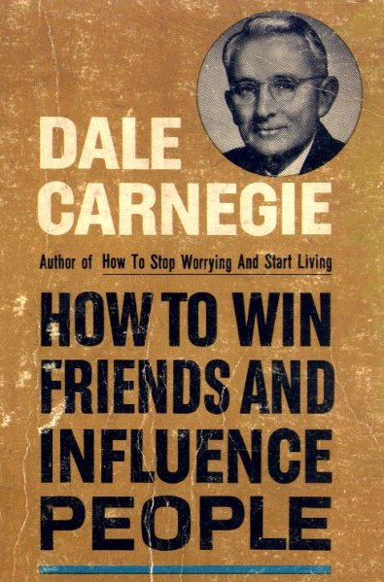
“You can make more friends in two months by becoming interested in other people than you can in two years trying to get other people interested in you.”
—Dale Carnegie
Notes:
But remember most people love talking about themselves, so if you can make the other person feel comfortable, engage them with thoughtful questions and be in the moment by acting interested, you’ll distinguish yourself from others.

Slide 6
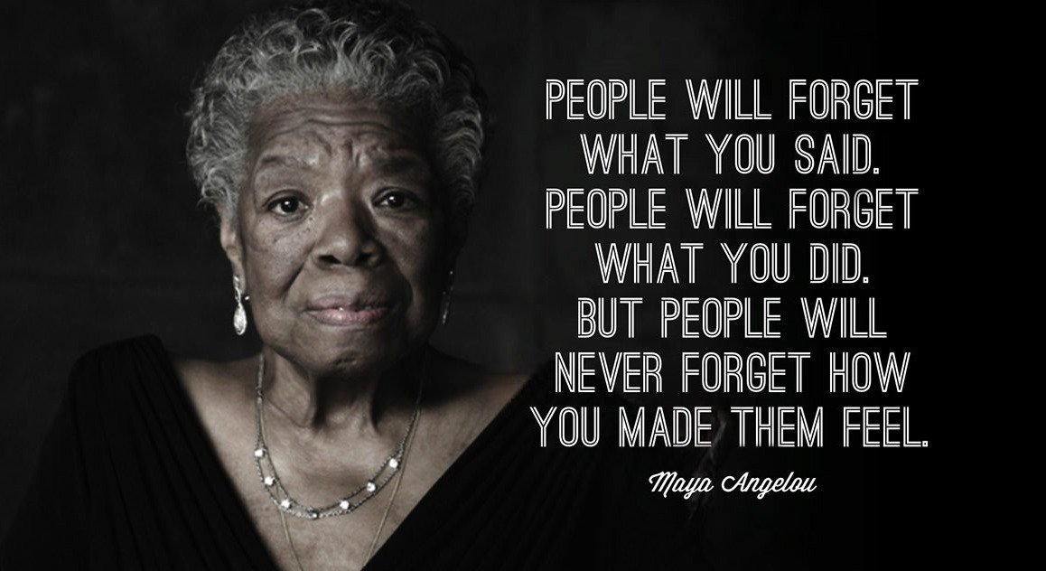

Slide 7
Your Big 5 Choices for Next 3 Years
Priority?
Industry
Vertical?
Job
Function?
Geography?
Compensation?
Minimum:
Ideal:
Intensity?
Work/life balance… OR
Ready to work hard…
Notes:
Big 5 choices for next 3-5 years

Slide 8
An Example
Priority?
Industry
Vertical?
Higher Ed – Grant administration
2
Job
Function?
Grant administrator
3
Geography?
Los Angeles/Orange County
1
Compensation?
Minimum: $75K
Ideal: $120K
2
Intensity?
Work/life balance… OR
Ready to work hard…
5
Notes:
Big 5 choices for next 3-5 years

Slide 9
People who get jobs are not always the most qualified. However, they apply for the job and they are comfortable, present, and respond authentically during recruiting interactions.
Notes:
Interviewing is an art/science – practice answers on peers and with advisors especially around topics of self-awareness to make sure answers sound authentic and are appropriate for job interview context
emotional quotient, a (notional) measure of a person's adequacy in such areas as self-awareness, empathy, and dealing sensitively with other people.

Slide 10
You Your unique talents or relevant skills/ experiences
Employer Attributes they are looking for
Value Proposition
Notes:
The big emphasis is the value proposition: transferrable, relevant skills that are matched to the companies needs such as the ones we identified in the resume videos from job descriptions.

Slide 11
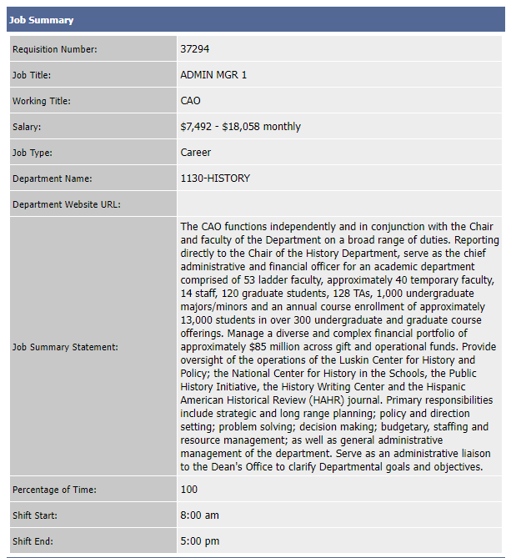
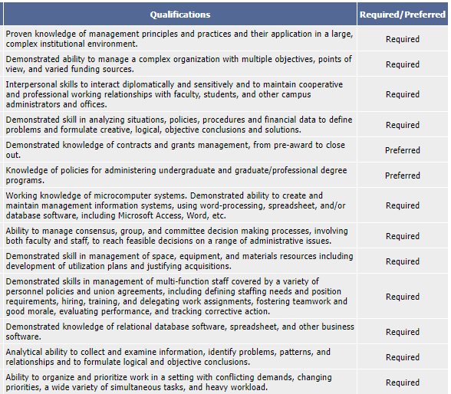
Management
Interpersonal/Team
What would be a compelling value proposition for this job?
Higher Ed/Grants
Technology

Slide 12
Personal Value Prop Worksheet
Identify your target audience and their needs
1
Identify your strengths
2
Connect your strengths to your target role
3
Provide evidence and success stories
4
Summarize succinctly in 2-3 sentences
5

Slide 13
Target Audience: Strategy consulting hiring manager
Your Strengths: Leadership, Work Ethic, Analytics
Connect Strengths to Target Role: Consulting firms need highly analytical people to do a lot of drudgery work in uncertain environments
Evidence and Success Stories: Naval Academy, Navy service, MBA, LEK Consulting summer internship
Succinct Summary: I am interested in strategy consulting. My experience at the Naval Academy and on Navy warships taught me how to be an effective leader even when the work is tedious. My summer internship at LEK confirmed that consulting involves a lot of non-glamourous, analytical work under tight timelines, but I like the pressure and analytical challenges and know that I can thrive in this kind of environment.
Pete Severs,
FTMBA ‘23
Notes:
Big 5 choices for next 3-5 years

Slide 14
What are the elements of a cover letter?
Header | Contact Information
Opening | Introduction Connections at the company
Body | Your why this company Value proposition (tailored to this company)
Closing | Next Steps Polite close Signature line

Slide 15
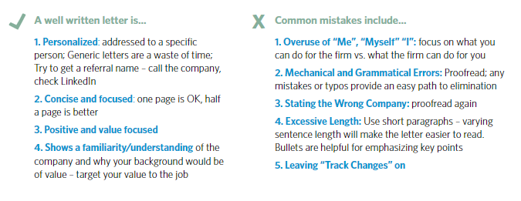

Slide 16
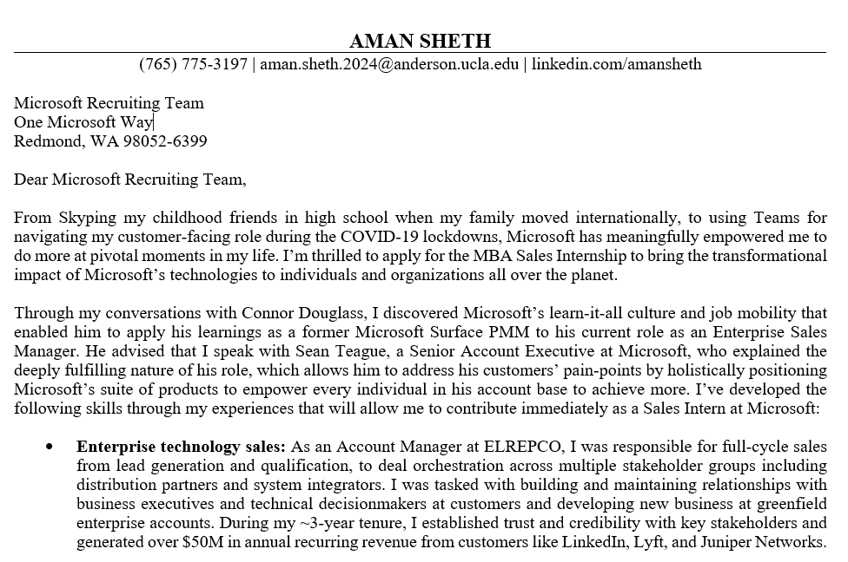

Slide 17
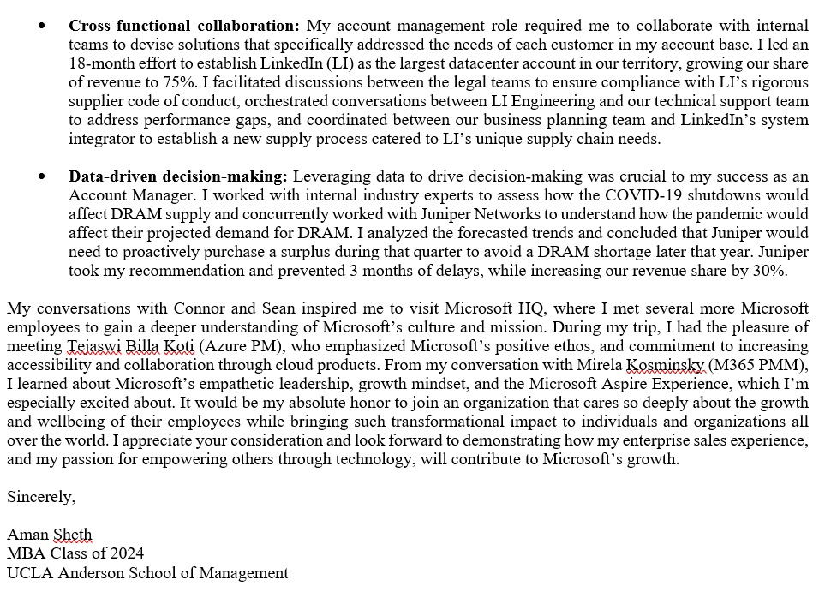

Slide 18
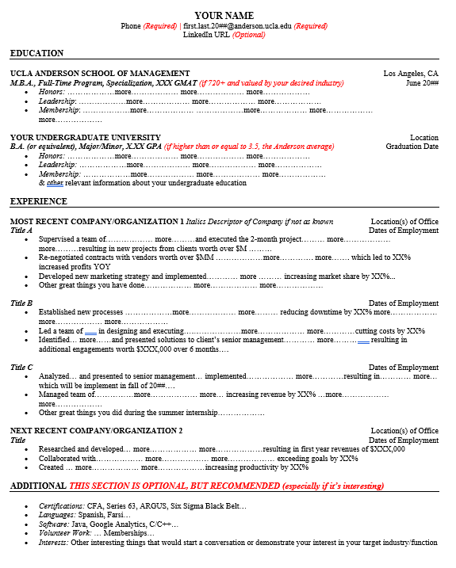
Resume Formatting
A resume is not a CV
Use a clean template, no images
1-page, maybe 2 pages for lots of experience
Sections (Education, Experience, Additional)
Functional resumes can highlight skills for a long tenure in a job
White space – more is not usually better
Easy to read – never less than 10 pt font (11 pt is better)

Slide 20
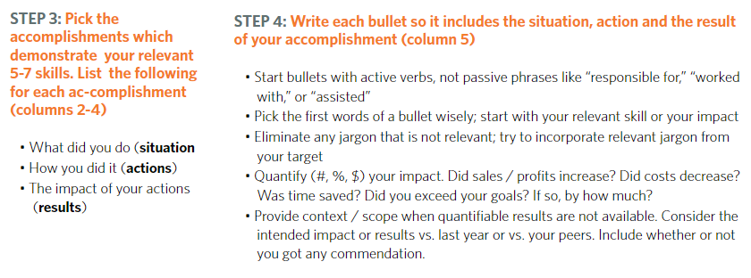

Slide 21
Interests: Long suffering Georgia sports fan: Falcons, Hawks, Braves, Dream, United, Panthers & Bulldogs
Please be interesting in your interests!
Interests: Huge foodie (dim sum is a top favorite), hiking fanatic, and travel adventurer (especially to off-the-beaten path track locations such as national parks of Chile or the jungles of Bali)
Interests: Golf (played to a 0.7 handicap through college), Soccer (played since age 7), Traveling (best experience: climbed to the summit of the tallest peak in North Africa, Jebel Toubkal, during a snow storm)
Notes:
This is why we have the interests at the bottom of the resumes to spark this type of dialogue.
What would you ask Charles about?
What would you ask Kelsey about?
And what about Brad?
Why are they picking the particular asking you?
They’re most likely interested in it themselves. Make sure you continue this in your conversation.

