Slide 1
What Are You Hoping to Learn Today?
As we wait for others to join,
use the chat feature to share what you are hoping to get out of this session.
FYI: the slides for this session will be shared afterwards.

Slide 2

How to Effectively Communicate Your Value Proposition in Interviews

Slide 3

Agenda
Intro: Interviewing
Refresher
  Your Value Proposition
  The Company’s Needs
Packaging Your Story
  The Three Things Structure
  Triangles vs. Diamonds
Closing

Slide 4
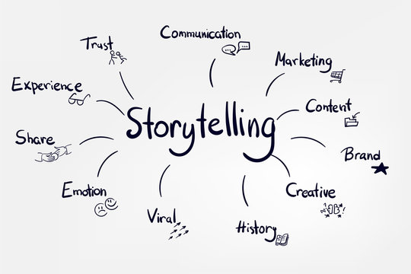
Intro: Interviewing is Storytelling
The story is you.
Who you are
What you skills and experience you have
What motivates you
How you want to grow
How you fit the company’s needs

Slide 5

Intro: Packaging Your Story
The Three Things Structure
  Use a Three Things Structure to list attributes or steps you took
Triangles vs. Diamonds
  Always diamonds. Avoid triangles.

Slide 6
Your Value Proposition

Slide 7
You
Your
unique
talents or
relevant skills/ experiences
Employer
Attributes
they are
looking for
Value
Proposition
Notes:
The big emphasis is the value proposition: transferrable, relevant skills that are matched to the companies needs

Slide 8
Your interview stories are informed by your value proposition
Walk me through your resume.
Skill Summary
Inventory your strengths before crafting your stories.
Find ways to pepper your some of your value proposition in every story.
Skill #1 + Experiences/Results
Skill #2 + Experiences/Results
Skill #3 + Experiences/Results
Conclusion and Fit with Role
Think of 5-7 strengths you have.
Put one of them in the chat box.

Slide 9
The Company’s Needs

Slide 10
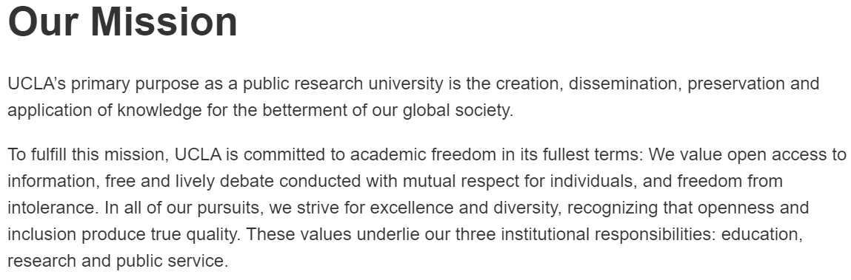
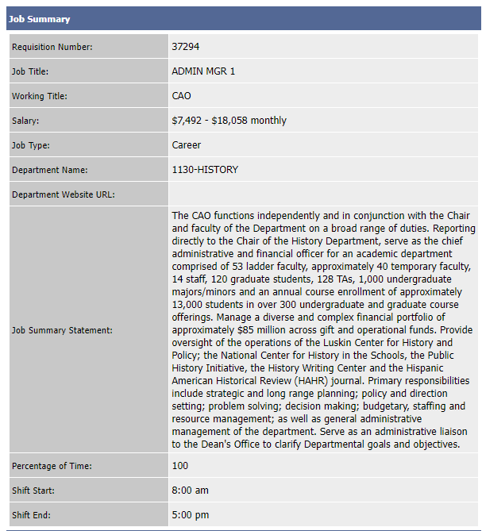
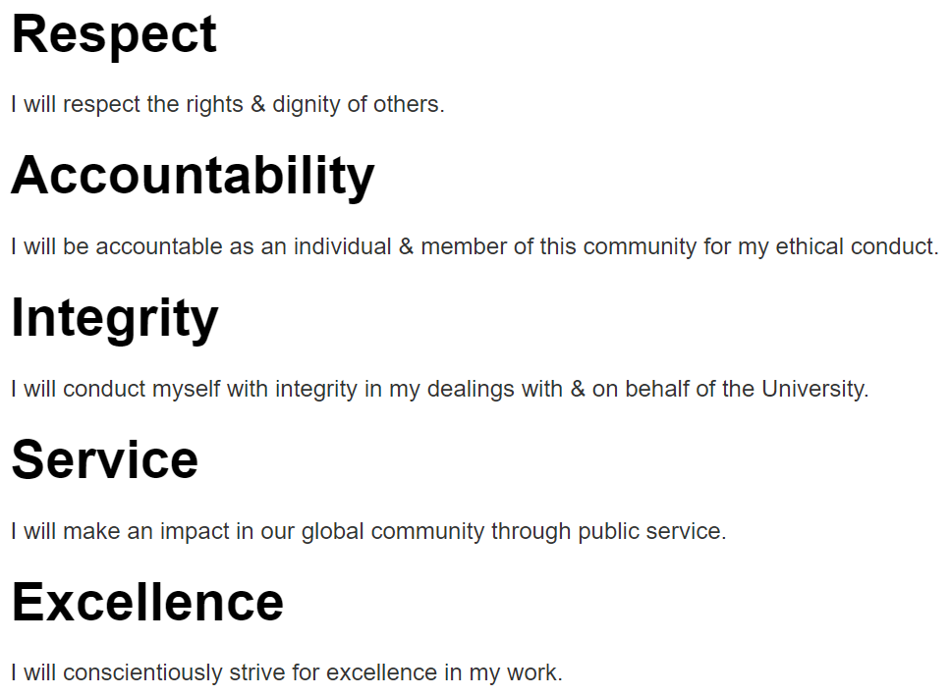
The Company’s Needs Show Up in Several Areas
https://www.ucla.edu/about/mission-and-values
https://truebruin.ucla.edu/
Notes:
Shows up in several areas:
Company mission
Company values
Job Description

Slide 11
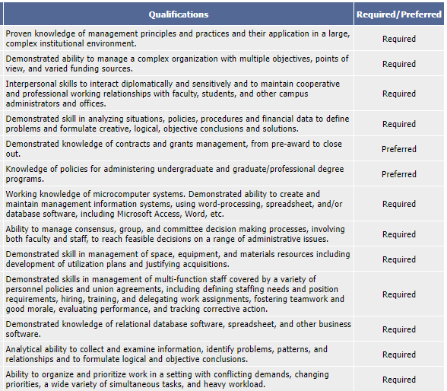
What would be a compelling value proposition for this job?
Management
Higher Ed/Grants
Interpersonal/Team
Technology

Slide 12
Packaging Your Story
The Three Things Structure

Slide 13
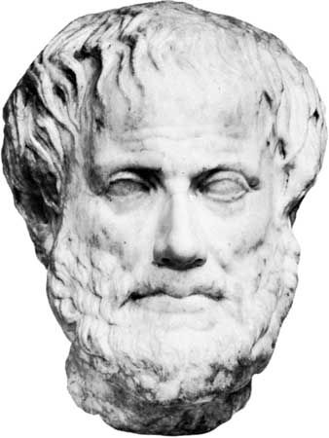
Aristotle’s Three Things
Tell them what you will tell them.
Tell them.
Tell them what you just told them.
https://www.inc.com/john-baldoni/deliver-a-great-speech-aristotle-three-tips.html

Slide 14
The Three Things Structure
Summary
Statement and List
Thing 1
Thing 2
Thing 3
“That’s why” closing

Slide 15

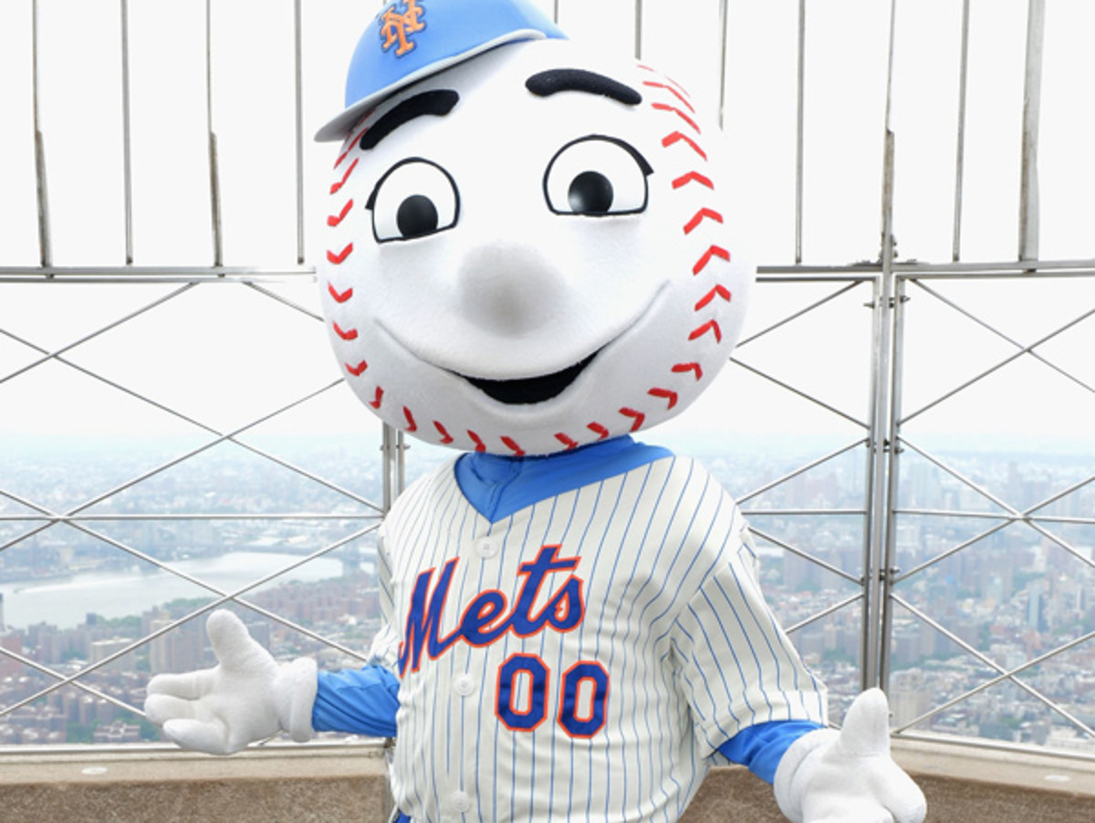
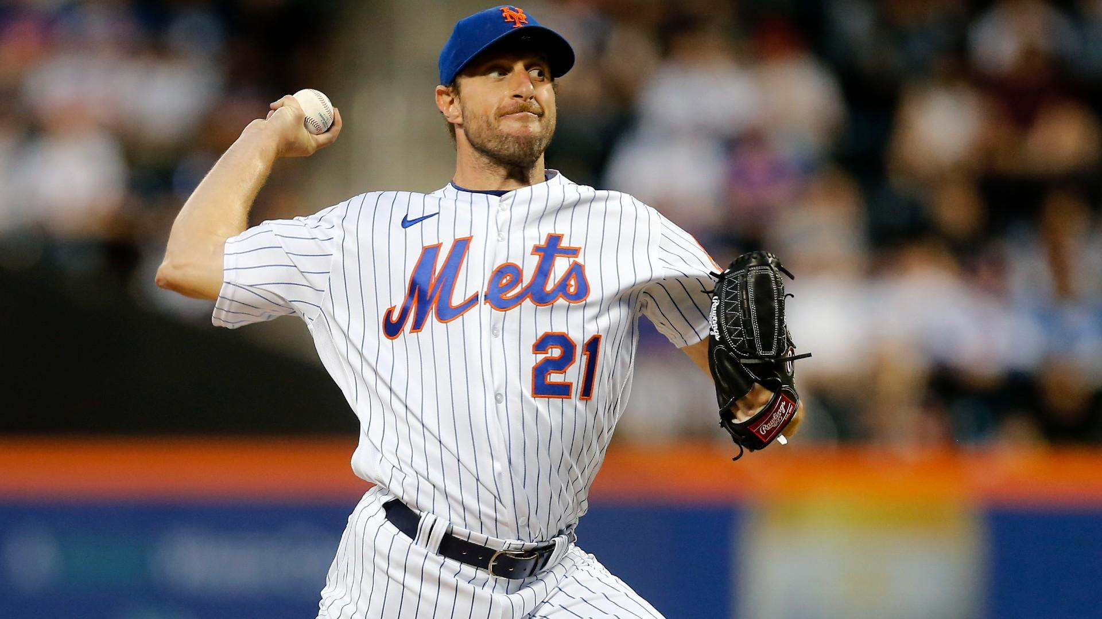

The Three Things Structure Applied
The Mets are the greatest baseball team this year because…
A culture of high expectations
Exceptional
pitching
A deep bench of contact hitters
That’s why the Mets will win the World Series this year.

Slide 16
The Greatest Exercise
Using the Three Things Structure, answer the following question:
What is the greatest (CATEGORY)?
You get to pick the category; here are some suggestions:
Book, movie, restaurant, city, sports team, art museum, vacation spot, etc.
2 person breakout rooms – practice delivering a three things answer.
Each person will have roughly 1 minute to answer the question

Slide 17
Three Things Types of Interview Questions
Why do you want to work here?
What made you want to apply to this role?
What would you think about when evaluating XYZ?
What do you believe were the drivers of your success?
What are your greatest strengths?

Slide 18
The Three Things Structure Applied
My greatest strengths are…
No more than 2.5 minutes
Strength #1 +
Short Example
Strength #2 +
Short Example
Strength #3 +
Short Example
I believe these strengths will allow me to contribute…

Slide 19
The Three Things Structure Applied
My greatest strengths are…
Analytical thinking
Empathic listener
Lead teams effectively
I believe these strengths will allow me to contribute…

Slide 20
Strengths Exercise
Using the Three Things Structure, answer the following question:
What are your greatest strengths?
2 person breakout rooms – practice delivering a three things answer.
Each person will have roughly 2 minutes to answer the question

Slide 21
Some Caveats on the Three Things
It doesn’t have to be three things
The summary statement should always sound different from your previous answer
Unless asked, avoid using three things for weakness-based or failure-related questions

Slide 22
Packaging Your Story
Triangles vs. Diamonds

Slide 23
Triangles vs. Diamonds
Actions
Results
Situation
Often feels less structured and/or unprepared
Tend to have too much context
Answers tend to go too long
Listener loses interest and/or cannot follow as easily

Slide 24
Triangles vs. Diamonds
Often feels more structured and/or prepared
Tend to be more focused
Situation more directly answers the question
Listener knows where the story is going right from the start
Results
Situation
Actions
Results

Slide 25
Diamond Types of Interview Questions
Tell me about a time when…
  You used data to make a decision.
  You had a conflict with a teammate or manager.
  You created a process to increase efficiency.
  You convinced someone of your idea.
  You led a project to completion.
  You collaborated cross-functionally.
What is your proudest accomplishment?

Slide 26
Proudest Accomplishment Diamond
Results: My greatest accomplishment is (ACTIVITY AND RESULT).
Situation: While working on (task), I needed to (action). Unfortunately, (BARRIERS) blocked the path to success. There were several options that I could choose: (OPTIONS 1, 2 and 3).
Actions: In order to choose the best path, I identified the following criteria: (DECISION-MAKING FRAMEWORK). I chose (OPTION) because (RATIONALE).
Results: Ultimately, (RESULTS). This is my proudest accomplishment because (RATIONALE/ VALUES).
Results
Situation
Actions
Results

Slide 27
Diamond Answer Pointers
Use a three things structure to transitions into your actions
Transition words guide your listener
  First, second, third
  Initially, then, next, finally

Slide 28
Closing

Slide 29
What Did You Learn Today?
Use the chat feature to share one thing you learned from this session.
FYI: the slides for this session will be shared afterwards.

Slide 30
Interview Chart Resource

Slide 31
Additional Resources
Examples of Interview Frameworks - Appendix
LinkedIn Learning
  Mastering Common Interview Questions
  Improving Your Listening Skills
Toastmasters
50+ Most Common Interview Questions

Slide 32
Appendix

Slide 33
Walk me through your Resume.
What the Question is Really Asking
What transferable skills did you obtain in your previous roles? Do you have a quick story to demonstrate proficiency with these skills?
What are the reasons you changed jobs/companies? Are there any red flags for why you left?
Are there any lengthy employment gaps?
How do you see yourself fitting in with the new role/company?
Possible
Response
Use a skills based answer when:
  You want to drive home the skills you bring to table right at the start
  Your story is non-linear and transitioning to the new role can’t be easily framed as a natural transition
  There are a few job transitions that will take a while to explain
  There are red flags in terms of employment gaps or why you left a company
Possible
High-Level
Answer
Framework
Skill Summary
Example
Detailed Answer
As you can see from my resume, I am (SKILL SUMMARY).
Skill #1 + Experiences/Results
As a (SKILL), I (HIGH-LEVEL RESULT). For example, (EXAMPLE).
Skill #2 + Experiences/Results
Additionally, I used my (SKILL) to (HIGH-LEVEL RESULT). At (PREVIOUS JOB), I (EXAMPLE).
Skill #3 + Experiences/Results
I also demonstrated (SKILL) while at (PREVIOUS JOB). For example, (EXAMPLE).
Conclusion and Fit with Role
I believe these skills and experience make me a great match for (ROLE)
Common Mistakes
  Skills demonstrated do not align to desired role
  Weak examples of skills
  Focusing your skills on only one job experience
  Highlighting what you are not instead of what you are
  Results not highlighted clearly
  Overstating your personal impact in the outcome

Slide 34
WHAT IS YOUR PROUDEST ACCOMPLISHMENT?
What the Question is Really Asking
Can you give me a sense of your personal values?
How do you make decisions?
Are you cognizant of the actions that led to your accomplishment?
What attributes do you define within someone who is successful?
Can I see you being successful in the role I am interviewing you for?
Possible
Response
Use an action-based approach to:
  Set and manage the context of the accomplishment
  Demonstrate self-understanding of what it took to be successful
  Highlight why you chose the path you did while rejecting other paths
  Reinforce previously discussed attributes or demonstrate additional skills that do not appear in other places
Possible
High-Level
Answer
Framework
Result
Situation
Actions
Result
Role Applying For
Build
Options
Decision
Why
Example
Detailed
Answer
My greatest accomplishment is (ACTIVITY AND RESULT).
While working on (task), I needed to (action).
Unfortunately, (BARRIERS) blocked the path to success.
In order to choose the best path, I identified the following criteria: (DECISION-MAKING FRAMEWORK).
Ultimately, (RESULTS),
This experience will aid me in providing value to (COMPANY), as (REASONS).
There were
several options that I could choose: (OPTIONS 1,
2 and 3).
I chose
(OPTION) because (RATIONALE).
This is my proudest accomplishment
because (RATIONALE/ VALUES).
Common Mistakes
  Accomplishment seems effortless
  Decision criteria is illogical
  Lack of understanding how actions led to success
  Result does not match actions
  Unable to demonstrate why this accomplishment can assist in new role
  Accomplishment is attributed to others or factors beyond control

Slide 35
What is your Greatest Weakness?
What the Question is Really Asking
Are you aware of your limitations?
What lessons have you learned from this weakness?
How have you tried to mitigate this weakness?
Is this weakness going to be detrimental to your ability to be successful in the role you are interviewing for?
Will this weakness limit your growth at the company you are interviewing for?
Possible
Response
Use the two stories approach to:
  Set and manage the context of the mistake
  Demonstrate self-understanding of your limitations
  Highlight what you’ve done to improve or mitigate this weakness
  Address any perceived weaknesses pre-emptively
Possible
High-Level
Answer
Framework
Answer + Context
Story #1
What You Learned
Story #2
Role Applying For
Build
Weakness
Build
Success
Example
Detailed
Answer
My greatest weakness is X. While working at (JOB), I was responsible for (TASK).
While working on (task), I needed to (action).
Unfortunately, I (ACTIONS THAT LED TO FAILURE).
This experience taught me (LESSONS LEARNED).
This time around, (RESULTS).
In the future, I will continue to (ACTIONS), which I know will be helpful in achieving success as a (ROLE).
I identified
that my (WEAKNESS)
led to (POOR RESULT).
In order to prevent this from occurring again, I (ACTIONS).
By (ACTIONS),
I not only (RESULTS), but also learned how best to
mitigate my
(WEAKNESS).
Common Mistakes
  Understating immediate corrective actions
  Understating evolution and growth
  Examples are weak
  Weakness identified is central to role you are applying for
  Lack of understanding of how to mitigate your weakness in new role
  Overstating your personal impact in the outcome

Slide 36
Why Company?
What the Question is Really Asking
What do you know about the industry we operate in?
What do you know about our business model, products, and culture?
How do you see yourself fitting in at our company?
How do your skills transfer to the role you are applying for?
Are you excited about our company and what you’ll be doing here, both short-term and long-term?
Possible
Response
Use a Macro-Micro-Me answer to:
  Demonstrate understand current trends in the industry and how the company’s business model is equipped to handle them
  Highlight your deep knowledge about the company’s products, culture
  Link your skills to the role you applying to
Possible
High-Level
Answer
Framework
Micro
Me
Macro
Example
Detailed Answer
(COMPANY) is at the leading edge for (TREND) because (REASONS).
My experiences will prove valuable to (COMPANY) because (SKILLS).
When I think about the (INDUSTRY) sector, I see (TRENDS).
Common Mistakes
  Lack of knowledge about industry trends
  Lack of knowledge of the company’s business model
  Insufficient transitions between sections
  Inability to tie skills to role

Slide 37
Thanks for Interviewing with Us.
What the Question is Really Asking
Nothing real. This is just the interviewer politely wrapping up the interview before you leave the interview room.
However, and only if it is appropriate, this is your opportunity to package your skills one more time and close effectively.
Possible
Response
Use this four-step approach to:
  Thank the interview by name
  State why you enjoyed the conversation, what you learned about from the interview, or what you learned about the company
  Remind the interviewer of your skills and how they fit with the role you are applying for
  Demonstrate interest in what’s next
Possible
High-Level
Answer
Framework
Say Thanks
Appreciate the Process
Skill Summary
Next Steps
Example
Detailed
Answer
My greatest accomplishment is (ACTIVITY AND RESULT).
I greatly enjoyed (PERSONAL CONNECTION TO COMPANY).
As we discussed, my (SKILLS) would allow me to immediately contribute as a (ROLE).
I look forward to hearing more about our next steps.
Common Mistakes
  Answer seems insincere
  Unable to link skills to future job
  Lack of showing interest in role or company

